Slide 1
Graph Algorithms-1
Lecture-9: Introduction & Graph Exploration
Md. Golam Shahriar,
Lecturer, Dept. of CSE, VU

Slide 2
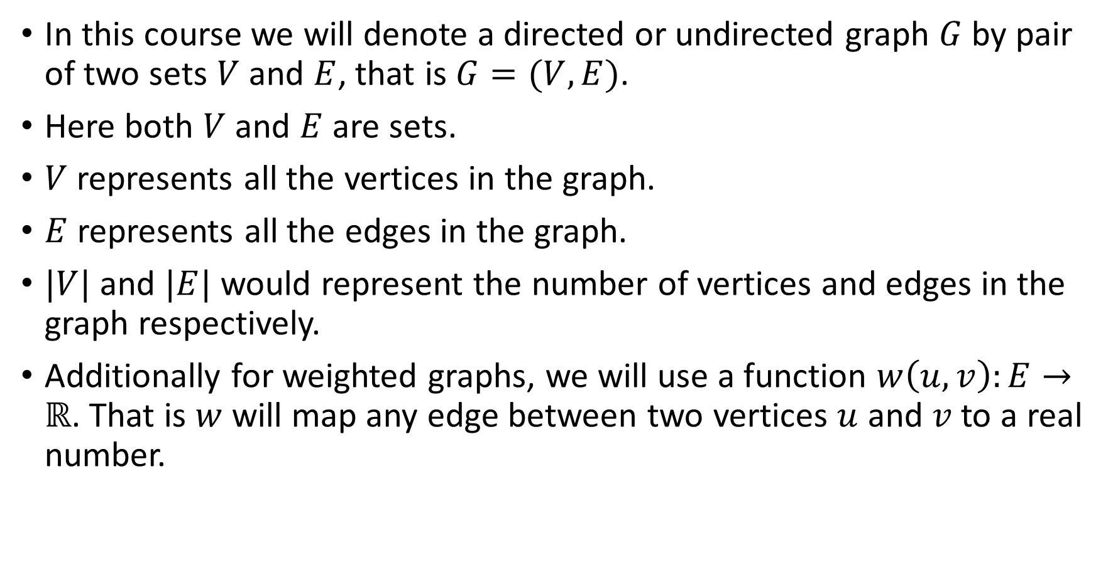
Graphs and Some Terminologies
In this course we will denote a directed or undirected graph $G$ by pair of two sets $V$ and $E$, that is $G=(V, E)$.
Here both $V$ and $E$are sets.
$V$ represents all the vertices in the graph.
$E$ represents all the edges in the graph.
$|V|$ and $|E|$ would represent the number of vertices and edges in the graph respectively.
Additionally for weighted graphs, we will use a function $w\left(u, v\right):E→ℝ$. That is $w$ will map any edge between two vertices $u$ and $v$ to a real number.

Slide 3
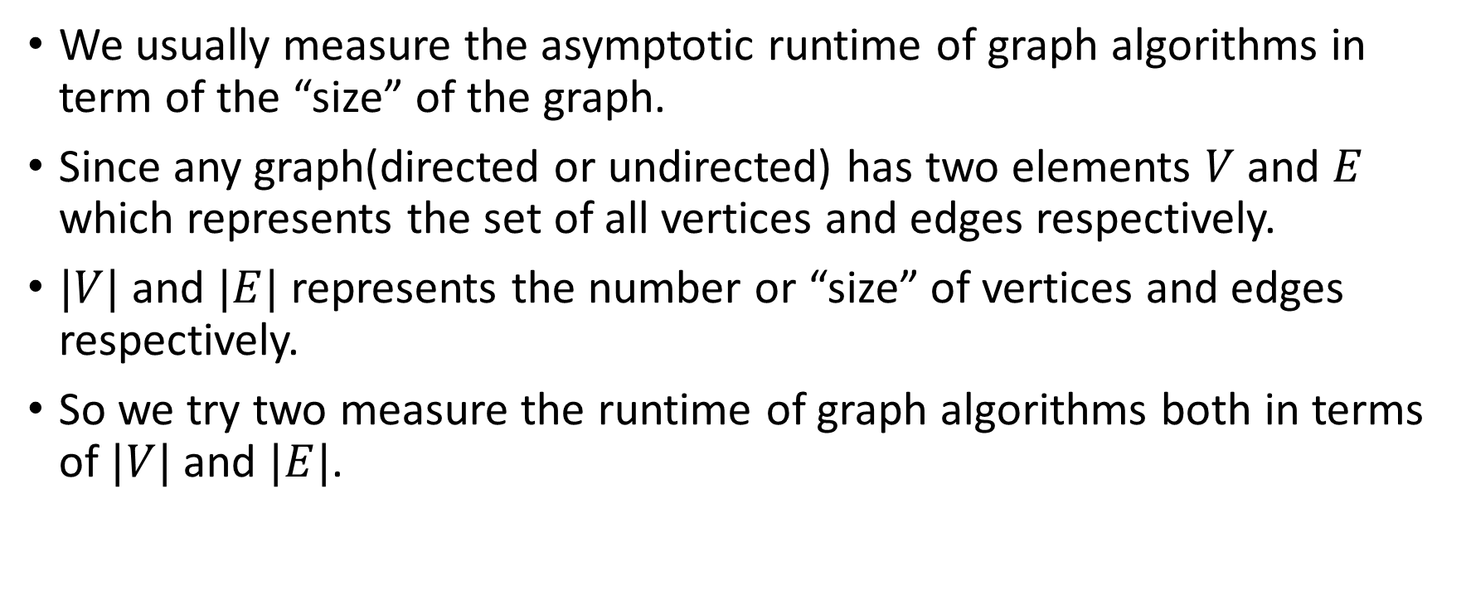
A Few Notes About The Runtime Analysis of Graph Algorithms
We usually measure the asymptotic runtime of graph algorithms in term of the “size” of the graph.
Since any graph(directed or undirected) has two elements $V$ and $E$ which represents the set of all vertices and edges respectively.
$|V|$ and $|E|$ represents the number or “size” of vertices and edges respectively.
So we try two measure the runtime of graph algorithms both in terms of $|V|$ and $|E|$.

Slide 4
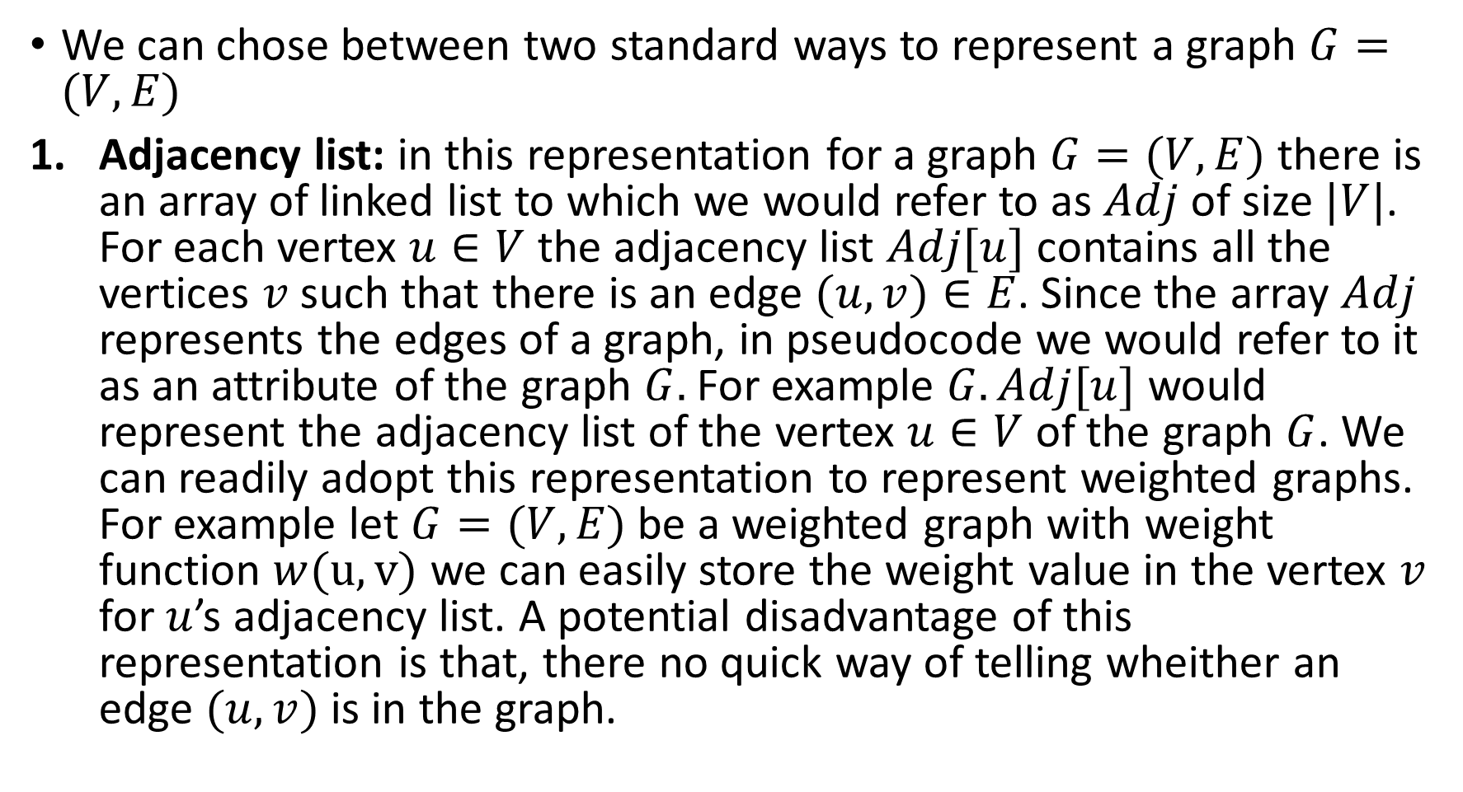
Representation of Graphs in Computer Memory
We can chose between two standard ways to represent a graph $G=(V,E)$
Adjacency list: in this representation for a graph $G=(V, E)$ there is an array of linked list to which we would refer to as $Adj$ of size $|V|$. For each vertex $u∈V$ the adjacency list $Adj[u]$ contains all the vertices $v$ such that there is an edge $(u, v)∈E$. Since the array $Adj$ represents the edges of a graph, in pseudocode we would refer to it as an attribute of the graph $G.$ For example $G.Adj[u]$ would represent the adjacency list of the vertex $u∈V$ of the graph $G$. We can readily adopt this representation to represent weighted graphs. For example let $G=(V, E)$ be a weighted graph with weight function $w(u, v)$ we can easily store the weight value in the vertex $v$ for $u$’s adjacency list. A potential disadvantage of this representation is that, there no quick way of telling wheither an edge $(u,v)$ is in the graph.

Slide 5
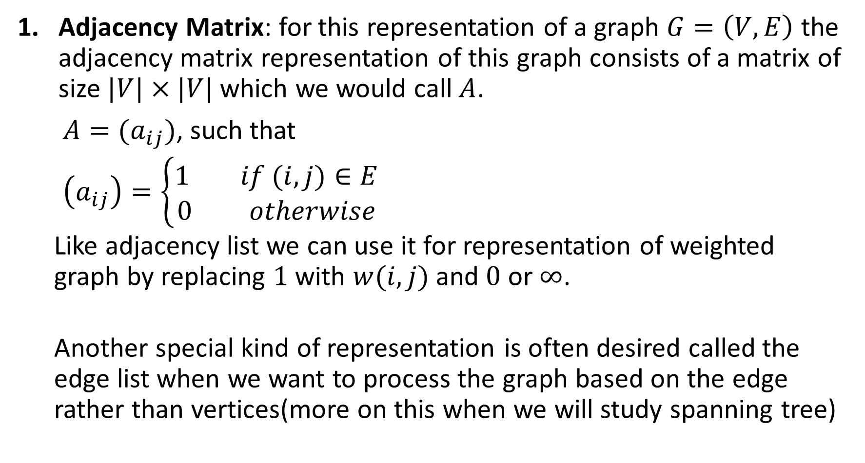
Representation of Graphs in Computer Memory
Adjacency Matrix: for this representation of a graph $G=\left(V, E\right)$ the adjacency matrix representation of this graph consists of a matrix of size $|V|×|V|$ which we would call $A$.
$A=(a_{ij})$, such that
$\left(a_{ij}\right)=\left\{\begin{aligned}1 if (i, j)∈E \\ 0 otherwise\end{aligned}\right.$
Like adjacency list we can use it for representation of weighted graph by replacing $1$ with $w(i, j)$ and $0$ or $∞$.
Another special kind of representation is often desired called the edge list when we want to process the graph based on the edge rather than vertices(more on this when we will study spanning tree)

Slide 6
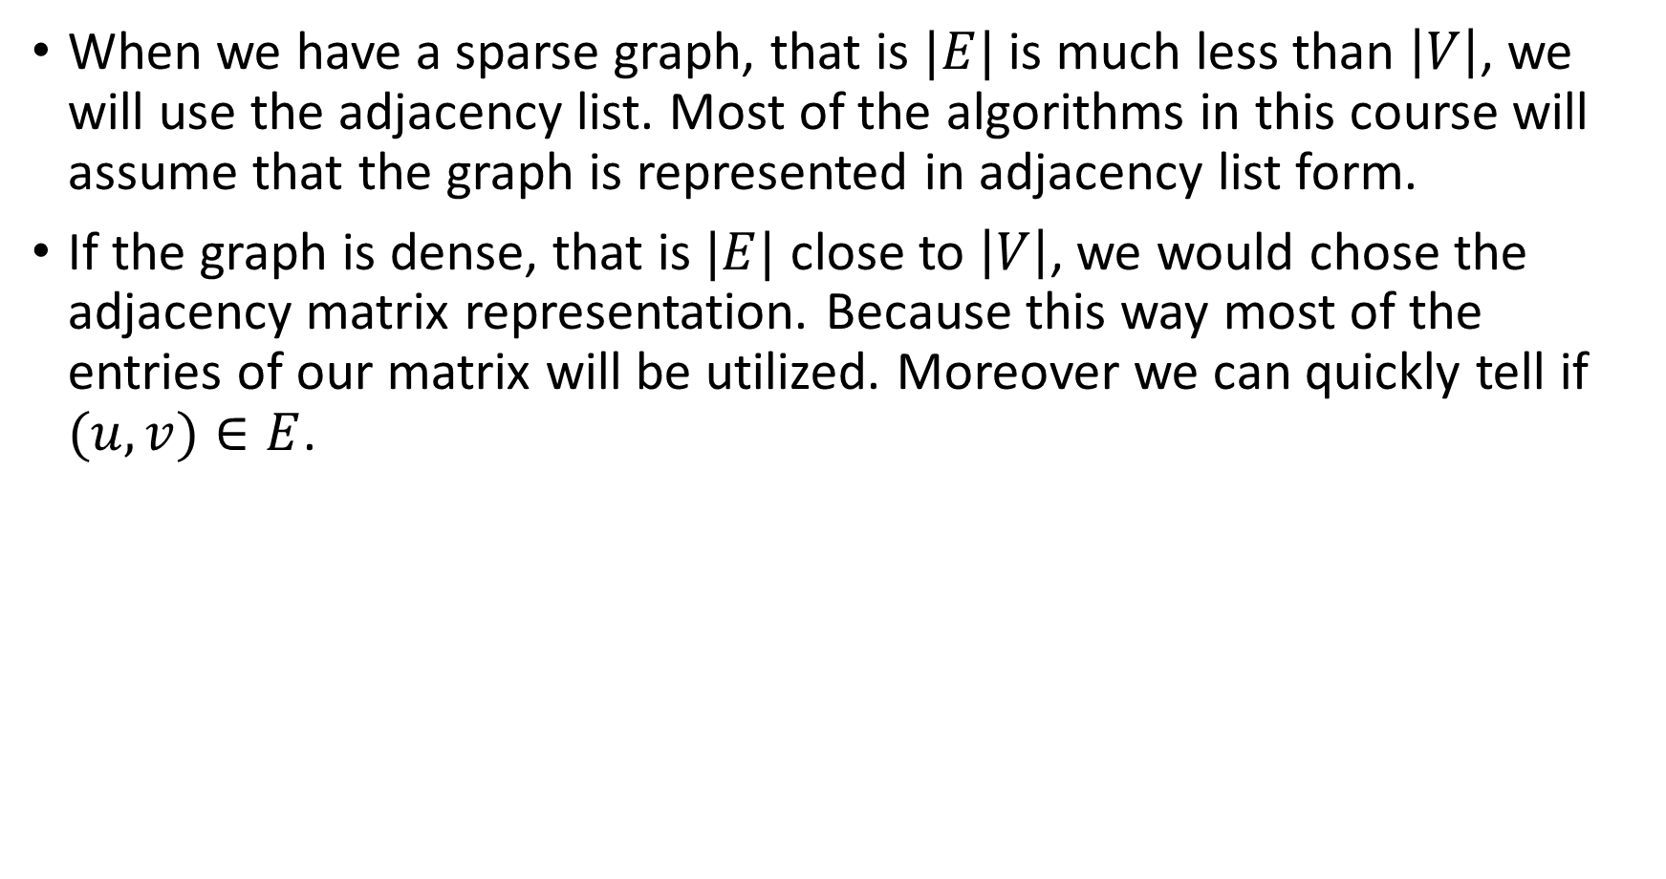
When to Use Which Representation
When we have a sparse graph, that is $|E|$ is much less than $\left|V\right|$, we will use the adjacency list. Most of the algorithms in this course will assume that the graph is represented in adjacency list form.
If the graph is dense, that is $|E|$ close to $\left|V\right|$, we would chose the adjacency matrix representation. Because this way most of the entries of our matrix will be utilized. Moreover we can quickly tell if $(u, v)∈E$.

Slide 7
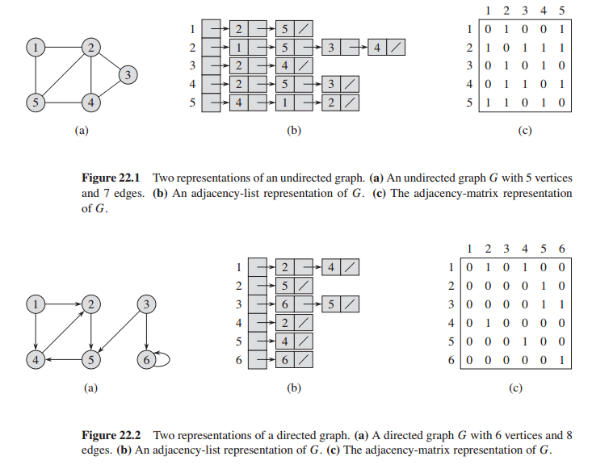

Slide 8

Representing Attributes in Graphs
Most algorithms that operates on graphs needs to store some additional information in vertices and or edges.
We refer to such attribute using the standard dot operator for example $v.d$ refers to the attribute $d$ of the vertex $v$.
Similarly $\left(u, v\right).f$ will represent the attribute $f$ of $\left(u, v\right)∈E.$

Slide 9
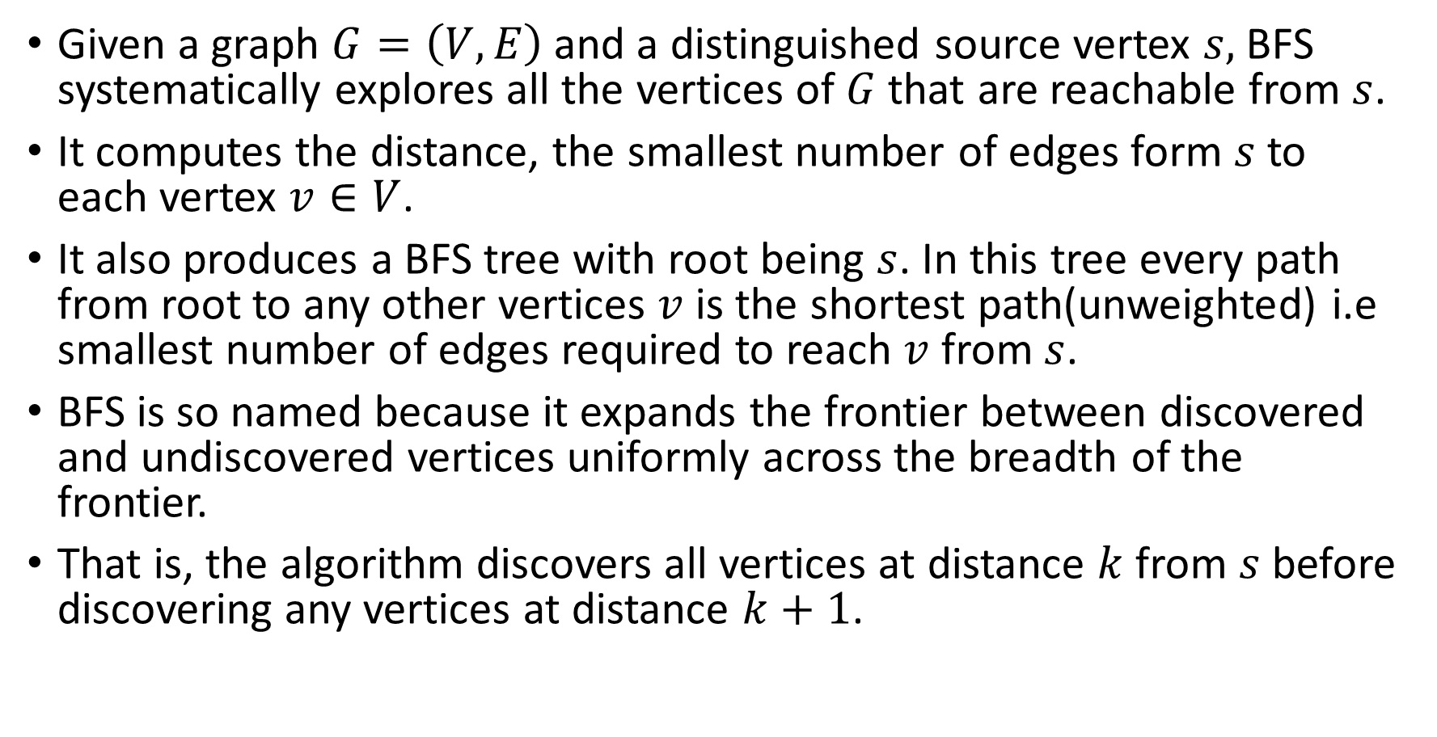
The Breadth First Search Algorithm(BFS)
Given a graph $G=\left(V,E\right)$and a distinguished source vertex $s,$BFS systematically explores all the vertices of $G$ that are reachable from $s$.
It computes the distance, the smallest number of edges form $s$ to each vertex $v∈V$.
It also produces a BFS tree with root being $s$. In this tree every path from root to any other vertices $v$ is the shortest path(unweighted) i.e smallest number of edges required to reach $v$ from $s$.
BFS is so named because it expands the frontier between discovered and undiscovered vertices uniformly across the breadth of the frontier.
That is, the algorithm discovers all vertices at distance $k$ from $s$ before discovering any vertices at distance $k+1$.

Slide 10
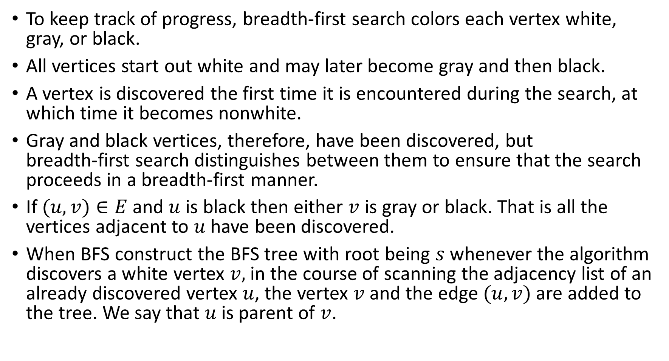
The Breadth First Search Algorithm(BFS)
To keep track of progress, breadth-first search colors each vertex white, gray, or black.
All vertices start out white and may later become gray and then black.
A vertex is discovered the first time it is encountered during the search, at which time it becomes nonwhite.
Gray and black vertices, therefore, have been discovered, but breadth-first search distinguishes between them to ensure that the search proceeds in a breadth-first manner.
If $(u,v)∈E$ and $u$ is black then either $v$ is gray or black. That is all the vertices adjacent to $u$ have been discovered.
When BFS construct the BFS tree with root being $s$ whenever the algorithm discovers a white vertex $v,$in the course of scanning the adjacency list of an already discovered vertex $u$, the vertex $v$ and the edge $(u, v)$ are added to the tree. We say that $u$is parent of $v$.

Slide 11
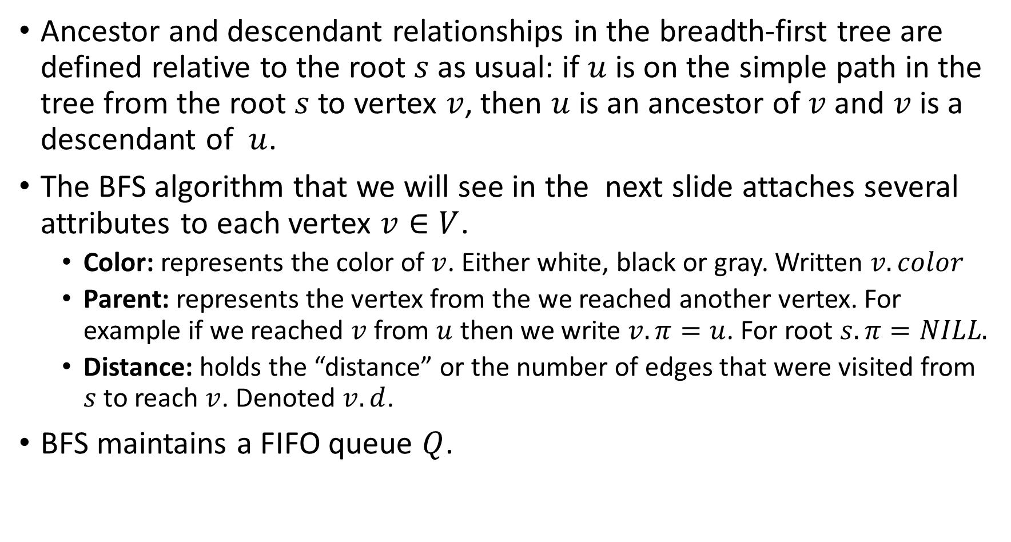
The Breadth First Search Algorithm(BFS)
Ancestor and descendant relationships in the breadth-first tree are defined relative to the root $s$ as usual: if $u$ is on the simple path in the tree from the root $s$ to vertex $v$, then $u$ is an ancestor of $v$ and $v$ is a descendant of $u$.
The BFS algorithm that we will see in the next slide attaches several attributes to each vertex $v∈V$.
Color: represents the color of $v$. Either white, black or gray. Written $v.color$
Parent: represents the vertex from the we reached another vertex. For example if we reached $v$ from $u$ then we write $v.π=u$. For root $s.π=NILL.$
Distance: holds the “distance” or the number of edges that were visited from $s$ to reach $v$. Denoted $v.d$.
BFS maintains a FIFO queue $Q$.

Slide 12

The BFS Algorithm
BFS($G,s$)
for each vertex $u∈G.V−\{s\}$
$u.color :=WHITE$
$u.d := ∞$
$u.π :=NILL$
$s.color :=GRAY$
$s.d :=0$
$s.π :=NILL$
$Q :=∅$
Enqueue($Q,s$)
while $Q≠∅$
$u ≔$Dequeue($Q)$
for each $v∈G.Adj[u]$
if $v.color=$WHITE
$v.color :=GRAY$
$v.d :=u.d+1$
$v.π :=u$
Enqueue($Q,v)$
$u.color :=BLACK$

Slide 13
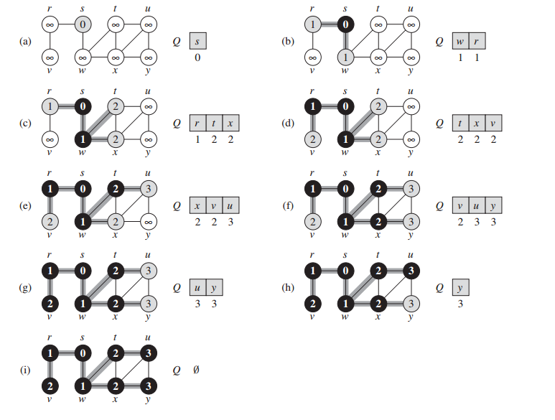

Slide 14
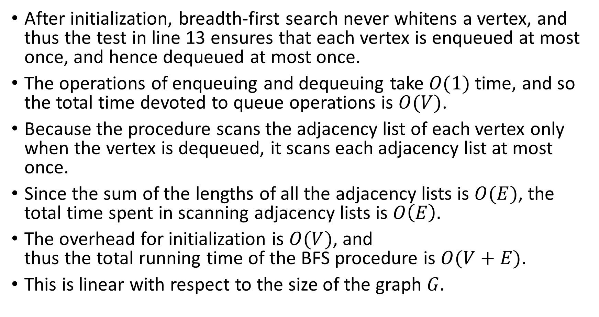
Runtime Analysis
After initialization, breadth-first search never whitens a vertex, and thus the test in line 13 ensures that each vertex is enqueued at most once, and hence dequeued at most once.
The operations of enqueuing and dequeuing take $O(1)$ time, and so the total time devoted to queue operations is $O(V)$.
Because the procedure scans the adjacency list of each vertex only when the vertex is dequeued, it scans each adjacency list at most once.
Since the sum of the lengths of all the adjacency lists is $O(E)$, the total time spent in scanning adjacency lists is $O\left(E\right).$
The overhead for initialization is $O(V)$, and thus the total running time of the BFS procedure is $O(V+E)$.
This is linear with respect to the size of the graph $G.$

Slide 15
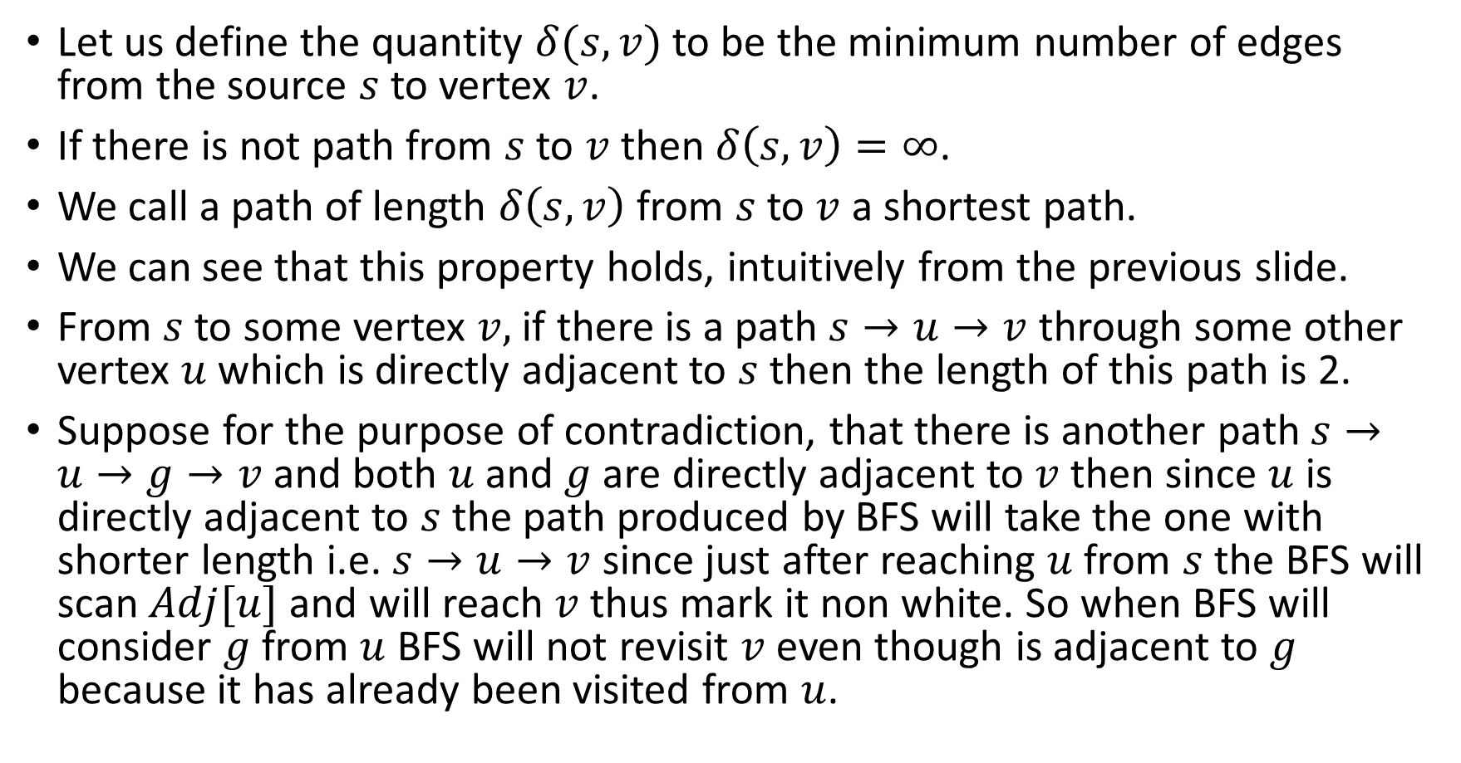
Some Important Properties of BFS: Shortest Paths
Let us define the quantity $δ(s, v)$ to be the minimum number of edges from the source $s$ to vertex $v$.
If there is not path from $s$ to $v$ then $δ\left(s,v\right)=∞$.
We call a path of length $δ\left(s,v\right)$ from $s$ to $v$ a shortest path.
We can see that this property holds, intuitively from the previous slide.
From $s$ to some vertex $v,$ if there is a path $s→u→v$ through some other vertex $u$ which is directly adjacent to $s$ then the length of this path is 2.
Suppose for the purpose of contradiction, that there is another path $s→u→g→v$ and both $u$and $g$ are directly adjacent to $v$then since $u$ is directly adjacent to $s$ the path produced by BFS will take the one with shorter length i.e. $s→u→v$ since just after reaching $u$ from $s$ the BFS will scan $Adj[u]$ and will reach $v$ thus mark it non white. So when BFS will consider $g$ from $u$ BFS will not revisit $v$ even though is adjacent to $g$ because it has already been visited from $u$.

Slide 16
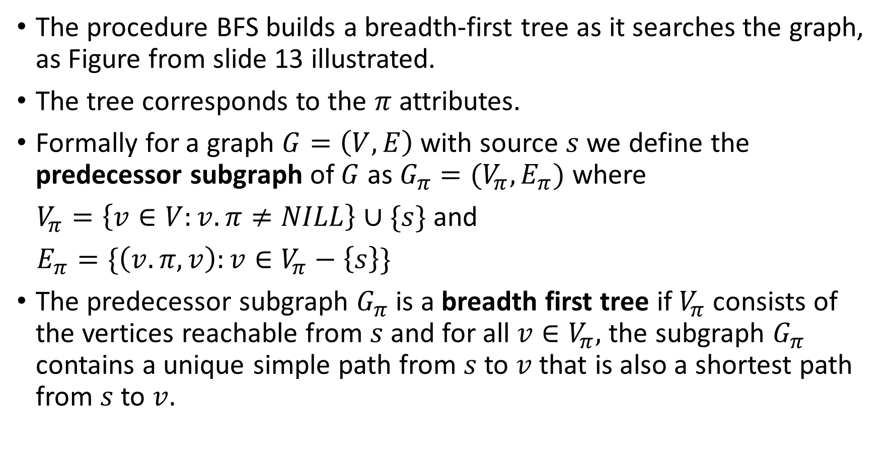
Some Important Properties of BFS: BFS Tree
The procedure BFS builds a breadth-first tree as it searches the graph, as Figure from slide 13 illustrated.
The tree corresponds to the $π$ attributes.
Formally for a graph $G=\left(V, E\right)$ with source $s$ we define the predecessor subgraph of $G$ as $G_{π}=(V_{π},E_{π})$ where
$V_{π}=\left\{v∈V:v.π≠NILL\right\}∪\{s\}$ and
$E_{π}=\{\left(v.π,v\right):v∈V_{π}−\left\{s\right\}\}$
The predecessor subgraph $G_{π}$is a breadth first tree if $V_{π}$consists of the vertices reachable from $s$ and for all $v∈V_{π},$ the subgraph $G_{π}$ contains a unique simple path from $s$ to $v$ that is also a shortest path from $s$ to $v.$

Slide 17

Printing the Paths
Print-Paths($G,s,v$)
if $v = s$
print $s$
elseif $v.π=NILL$
print “no path from s to v”
else
Print-Path($G,s,v.π$)
print $v$

Slide 18
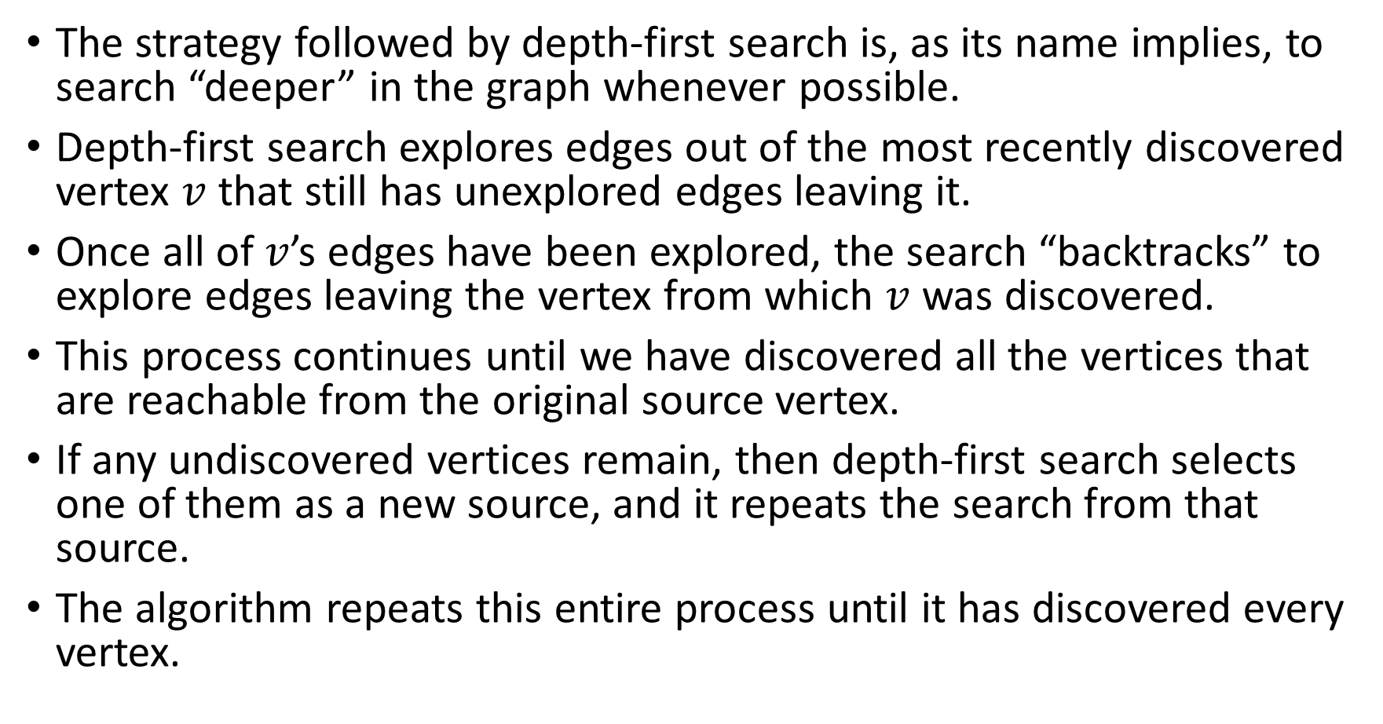
Depth First Search: DFS
The strategy followed by depth-first search is, as its name implies, to search “deeper” in the graph whenever possible.
Depth-first search explores edges out of the most recently discovered vertex $v$ that still has unexplored edges leaving it.
Once all of $v$’s edges have been explored, the search “backtracks” to explore edges leaving the vertex from which $v$ was discovered.
This process continues until we have discovered all the vertices that are reachable from the original source vertex.
If any undiscovered vertices remain, then depth-first search selects one of them as a new source, and it repeats the search from that source.
The algorithm repeats this entire process until it has discovered every vertex.

Slide 19
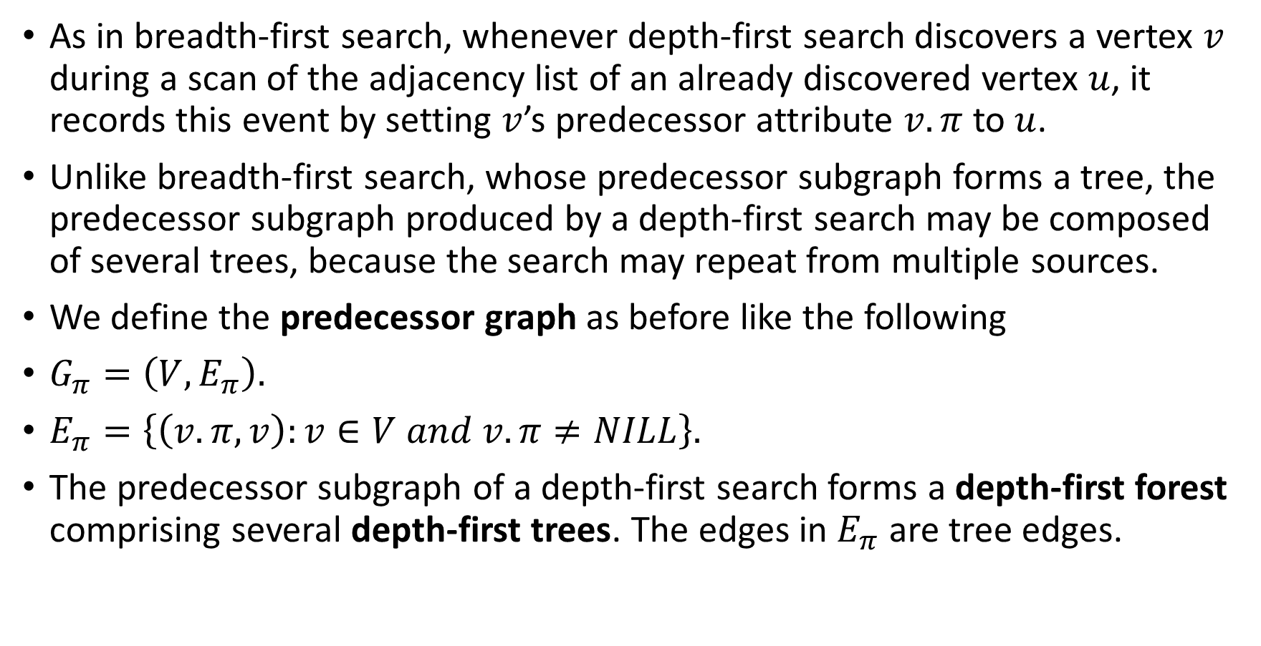
Depth First Search: DFS
As in breadth-first search, whenever depth-first search discovers a vertex $v$ during a scan of the adjacency list of an already discovered vertex $u$, it records this event by setting $v$’s predecessor attribute $v.π$ to $u$.
Unlike breadth-first search, whose predecessor subgraph forms a tree, the predecessor subgraph produced by a depth-first search may be composed of several trees, because the search may repeat from multiple sources.
We define the predecessor graph as before like the following
$G_{π}=\left(V,E_{π}\right).$
$E_{π}=\left\{\left(v.π,v\right):v∈V and v.π≠NILL\right\}.$
The predecessor subgraph of a depth-first search forms a depth-first forest comprising several depth-first trees. The edges in $E_{π}$ are tree edges.

Slide 20
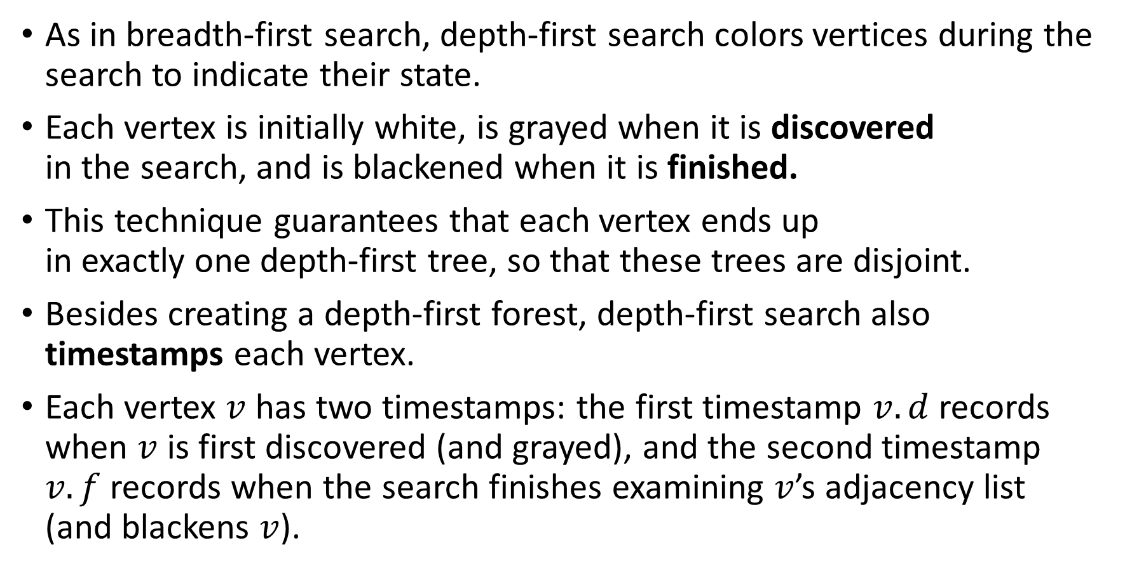
Depth First Search: DFS
As in breadth-first search, depth-first search colors vertices during the search to indicate their state.
Each vertex is initially white, is grayed when it is discovered in the search, and is blackened when it is finished.
This technique guarantees that each vertex ends up in exactly one depth-first tree, so that these trees are disjoint.
Besides creating a depth-first forest, depth-first search also timestamps each vertex.
Each vertex $v$ has two timestamps: the first timestamp $v.d$ records when $v$ is first discovered (and grayed), and the second timestamp $v.f$ records when the search finishes examining $v$’s adjacency list (and blackens $v$).

Slide 21

The Algorithm
DFS($G$)
for each $u∈G.V$
$u.color :=WHITE$
$u.π :=NILL$
$time :=0$ //a “global” variable
for each $u∈G.V$
if $u.color=WHITE$
DFS-Visit($G,u)$
DFS-Visit($G,u$)
$time :=time+1$
$u.d :=$ $time$
$u.color :=GRAY$
for each $v∈G.Adj\left[u\right]$
if $v.color=WHITE$
$v.π :=u$
DFS-Visit($G,v$)
$u.color :=BLACK$
$time :=time+1$
$u.f :=time$

Slide 22
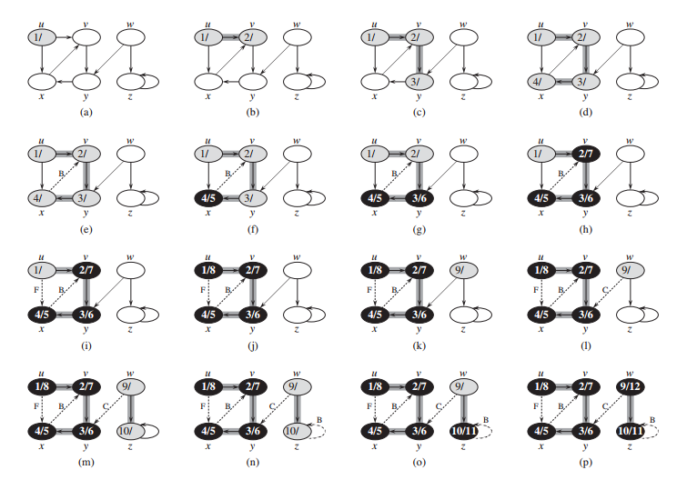

Slide 23
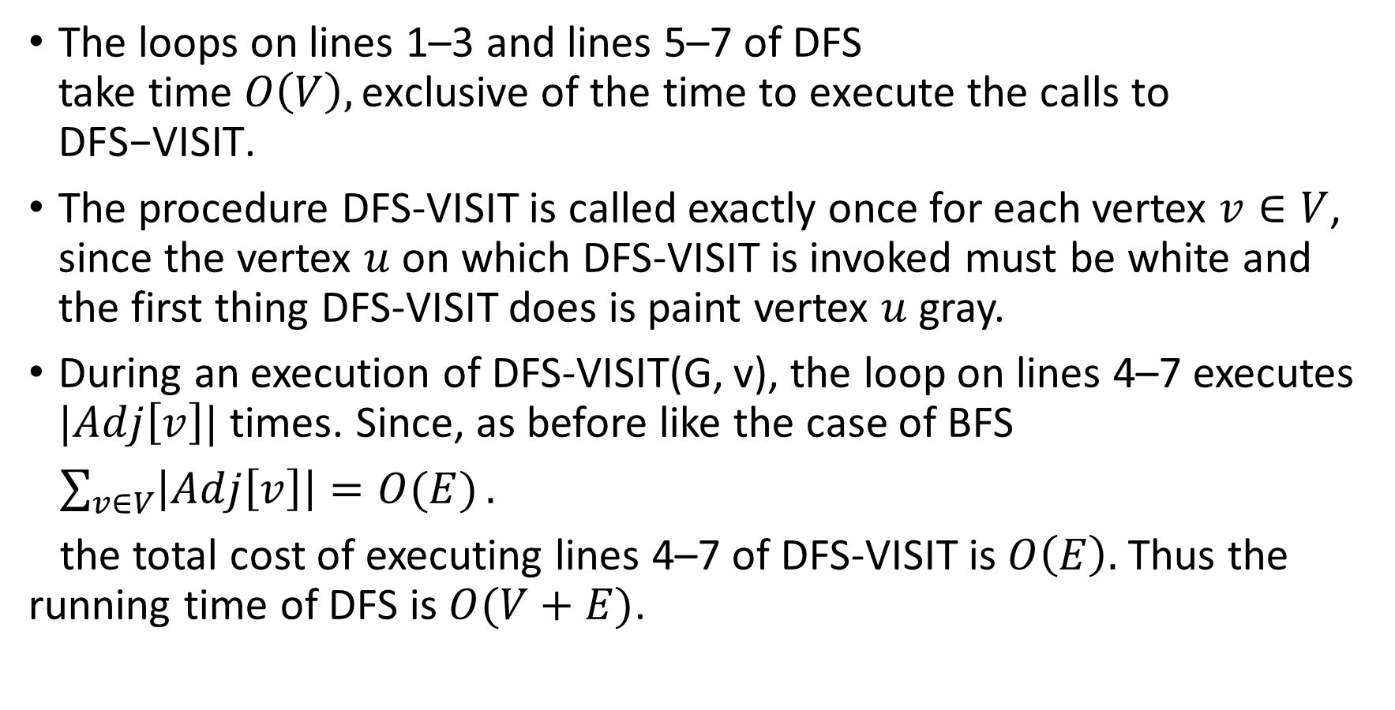
Runtime Analysis of DFS
The loops on lines 1–3 and lines 5–7 of DFS take time $O\left(V\right),\text{exclusive} \text{of} \text{the} \text{time} \text{to} \text{execute} \text{the} \text{calls} \text{to} \text{DFS}\text{−}\text{VISIT}\text{.}$
The procedure DFS-VISIT is called exactly once for each vertex $v∈V$, since the vertex $u$ on which DFS-VISIT is invoked must be white and the first thing DFS-VISIT does is paint vertex $u$ gray.
During an execution of DFS-VISIT(G, v), the loop on lines 4–7 executes $|Adj\left[v\right]|$ times. Since, as before like the case of BFS
$\sum_{v∈V}{\left|Adj\left[v\right]\right|=O(E)}.$
the total cost of executing lines 4–7 of DFS-VISIT is $O\left(E\right).$ Thus the running time of DFS is $O(V+E)$.

Slide 24
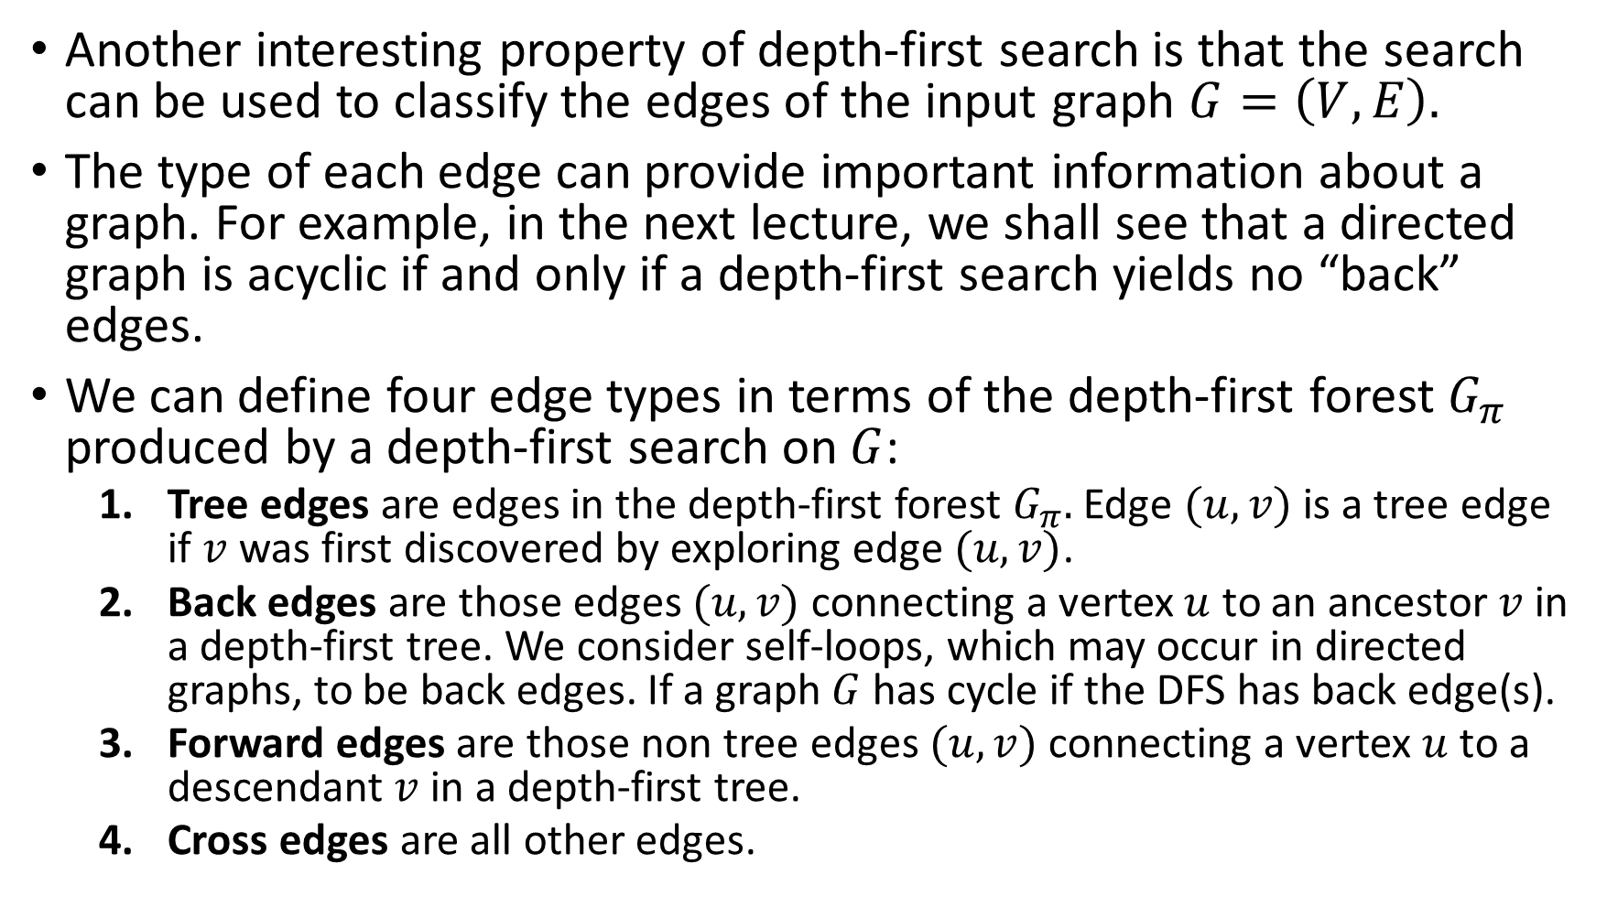
Classification of Edges Produced by DFS Tree
Another interesting property of depth-first search is that the search can be used to classify the edges of the input graph $G=\left(V,E\right).$
The type of each edge can provide important information about a graph. For example, in the next lecture, we shall see that a directed graph is acyclic if and only if a depth-first search yields no “back” edges.
We can define four edge types in terms of the depth-first forest $G_{π}$ produced by a depth-first search on $G$:
Tree edges are edges in the depth-first forest $G_{π}.$ Edge $(u,v)$ is a tree edge if $v$ was first discovered by exploring edge $(u,v)$.
Back edges are those edges $(u,v)$ connecting a vertex $u$ to an ancestor $v$ in a depth-first tree. We consider self-loops, which may occur in directed graphs, to be back edges. If a graph $G$has cycle if the DFS has back edge(s).
Forward edges are those non tree edges $(u,v)$ connecting a vertex $u$ to a descendant $v$ in a depth-first tree.
Cross edges are all other edges.

Slide 25
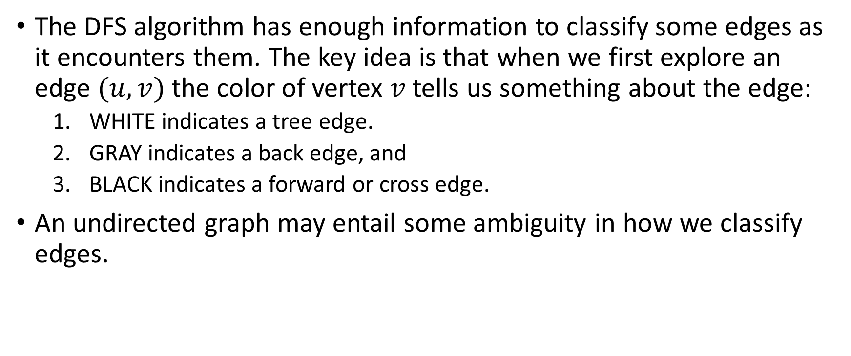
Classification of Edges Produced by DFS Tree
The DFS algorithm has enough information to classify some edges as it encounters them. The key idea is that when we first explore an edge $(u,v)$ the color of vertex $v$ tells us something about the edge:
WHITE indicates a tree edge.
GRAY indicates a back edge, and
BLACK indicates a forward or cross edge.
An undirected graph may entail some ambiguity in how we classify edges.

Slide 26
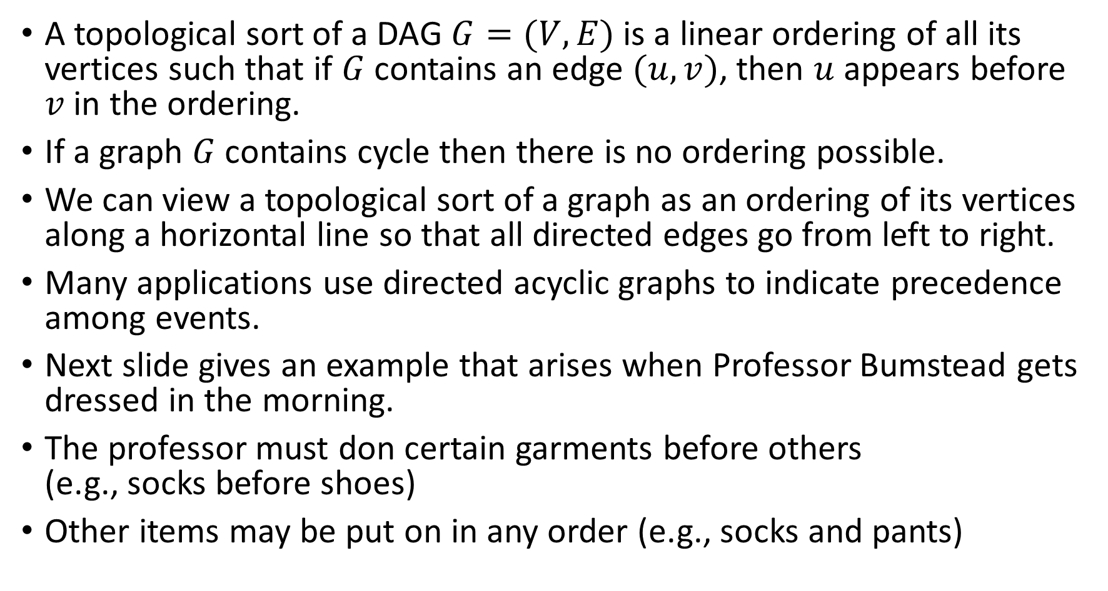
Topological Sort
A topological sort of a DAG $G=(V,E)$ is a linear ordering of all its vertices such that if $G$ contains an edge $(u,v)$, then $u$ appears before $v$ in the ordering.
If a graph $G$ contains cycle then there is no ordering possible.
We can view a topological sort of a graph as an ordering of its vertices along a horizontal line so that all directed edges go from left to right.
Many applications use directed acyclic graphs to indicate precedence among events.
Next slide gives an example that arises when Professor Bumstead gets dressed in the morning.
The professor must don certain garments before others (e.g., socks before shoes)
Other items may be put on in any order (e.g., socks and pants)

Slide 27
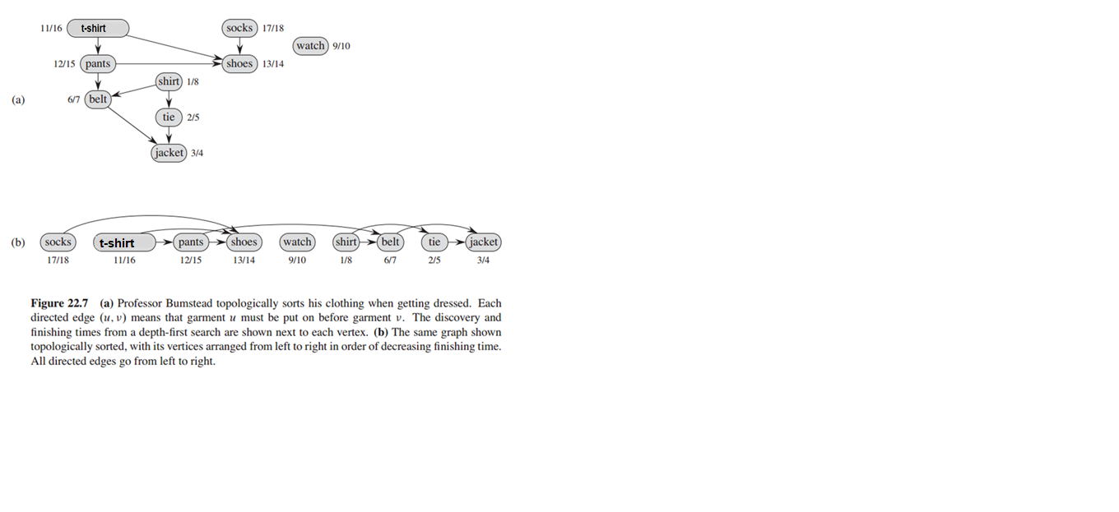

Slide 28
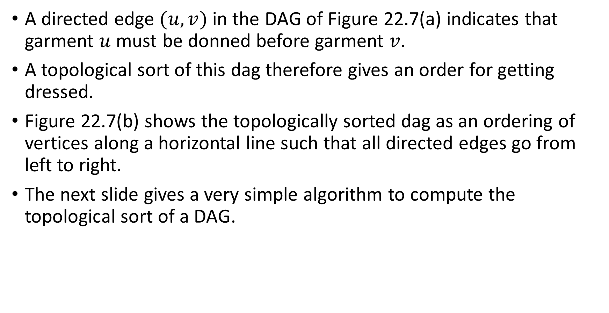
On The Previous Example
A directed edge $(u,v)$ in the DAG of Figure 22.7(a) indicates that garment $u$ must be donned before garment $v$.
A topological sort of this dag therefore gives an order for getting dressed.
Figure 22.7(b) shows the topologically sorted dag as an ordering of vertices along a horizontal line such that all directed edges go from left to right.
The next slide gives a very simple algorithm to compute the topological sort of a DAG.

Slide 29
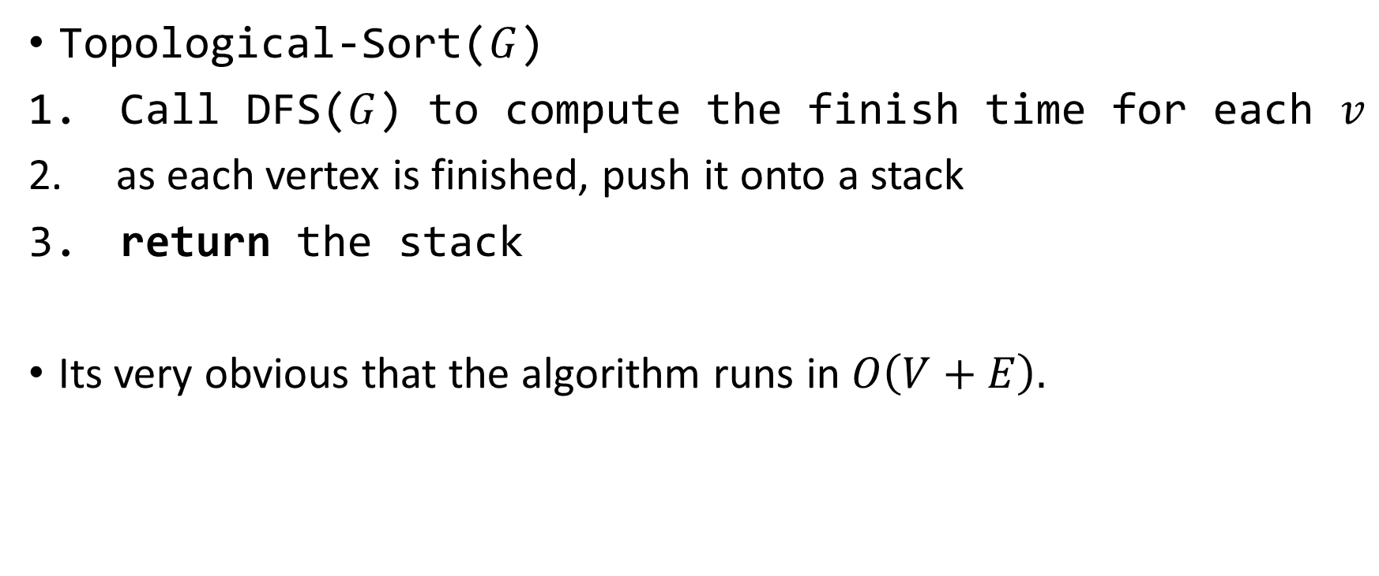
Topological Sorting Algorithm and Its Runtime
Topological-Sort($G$)
Call DFS($G$) to compute the finish time for each $v$
as each vertex is finished, push it onto a stack
return the stack
Its very obvious that the algorithm runs in $O\left(V+E\right).$

